Slide 1
Data Reporting: A Closer Look at pulling data from Prevention Data Portal
for Monthly Reimbursement Reporting
DAODAS Prevention Team
November 2, 2023
Notes:
Custom DAODAS color codes is : Red-0
Green-131
Blue-139

Slide 2
Data Reporting Standards From Prevention Standards Manual:
Minimum standards for accuracy of monthly data entered into the web-based reporting system are as follows:
a) correct application of service categories (direct vs. indirect) and populations served;
b) required monthly documentation of service hours for any organizational member or volunteer who is providing prevention services;
c) Demographics of people served in prevention services as required for federal reporting;
d) appropriate documentation of funding and reporting to ensure compliance.
**These are just a few highlights from the Manual, please read the entire document and contact DAODAS with any questions.

Slide 3
New projects for this fiscal year in GMS: SABG23-PR-ALL-XXX-20230701-20240630
Please complete all fields (even the ones that are not labeled as required) to ensure that the integrity of the data is high.
If you have a question related to data forms, please contact prevention@daodas.sc.gov to ensure accurate information is reported.
If you have questions related to accessing the prevention data portal, please contact gms-support@daodas.sc.gov and cc prevention@daodas.sc.gov

Slide 4
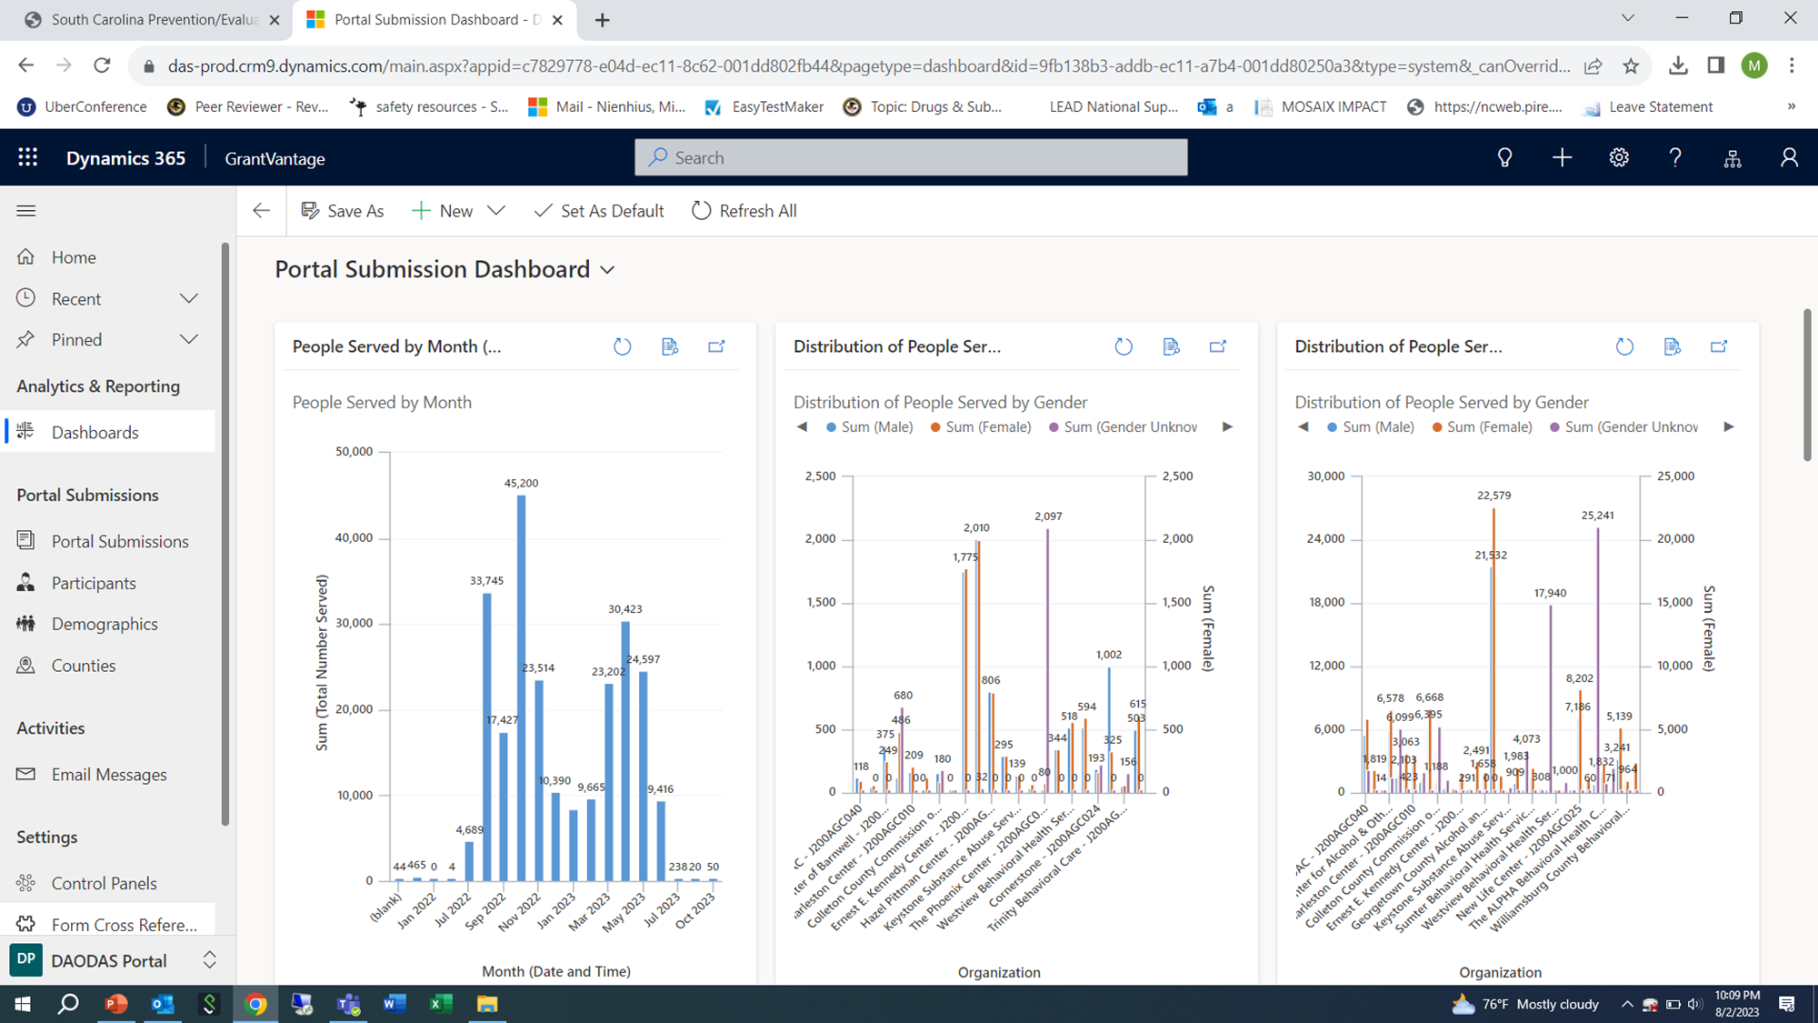
Steps for pulling data from Prevention Data Portal through GMS:
1. Bottom left-hand corner- Click on blue G-GrantVantage symbol and change view to DAODAS Portal (DP) view

Slide 5
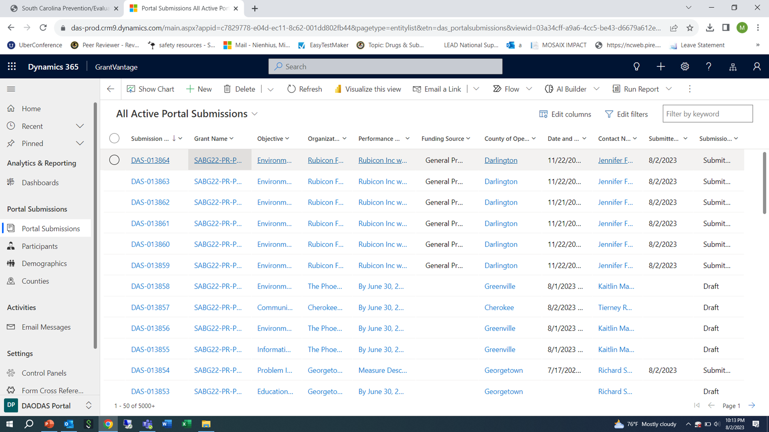
2. On left-hand side, click on “Portal Submission”

Slide 6
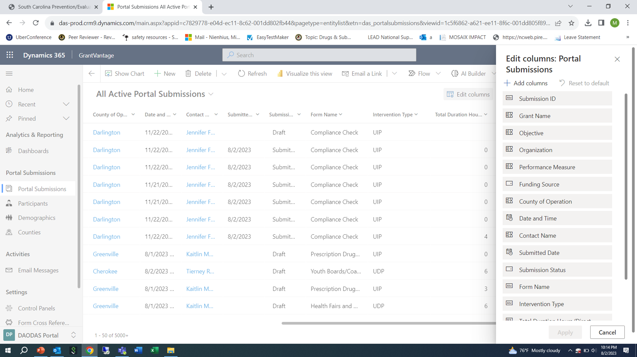
3. On top right, click on “Edit Columns” to bring up a menu on right side.

Slide 7
4. Click “+ Add Columns” to add the following columns to the report:
Form Name
Intervention Type
Total Duration Hours
Total Duration Minutes
Strategy
You can add the columns by typing the heading in the search bar (Form Name) and then select the heading and click “close”.
This will then take you back to the list.
Repeat the steps to continue to add each one until you have all of the additional columns added to the list.

Slide 8
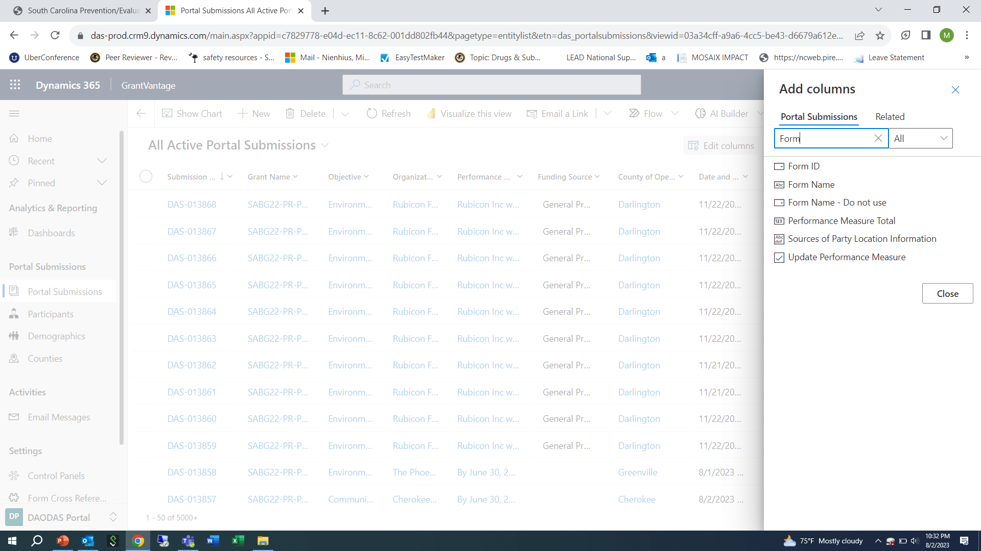

Slide 9
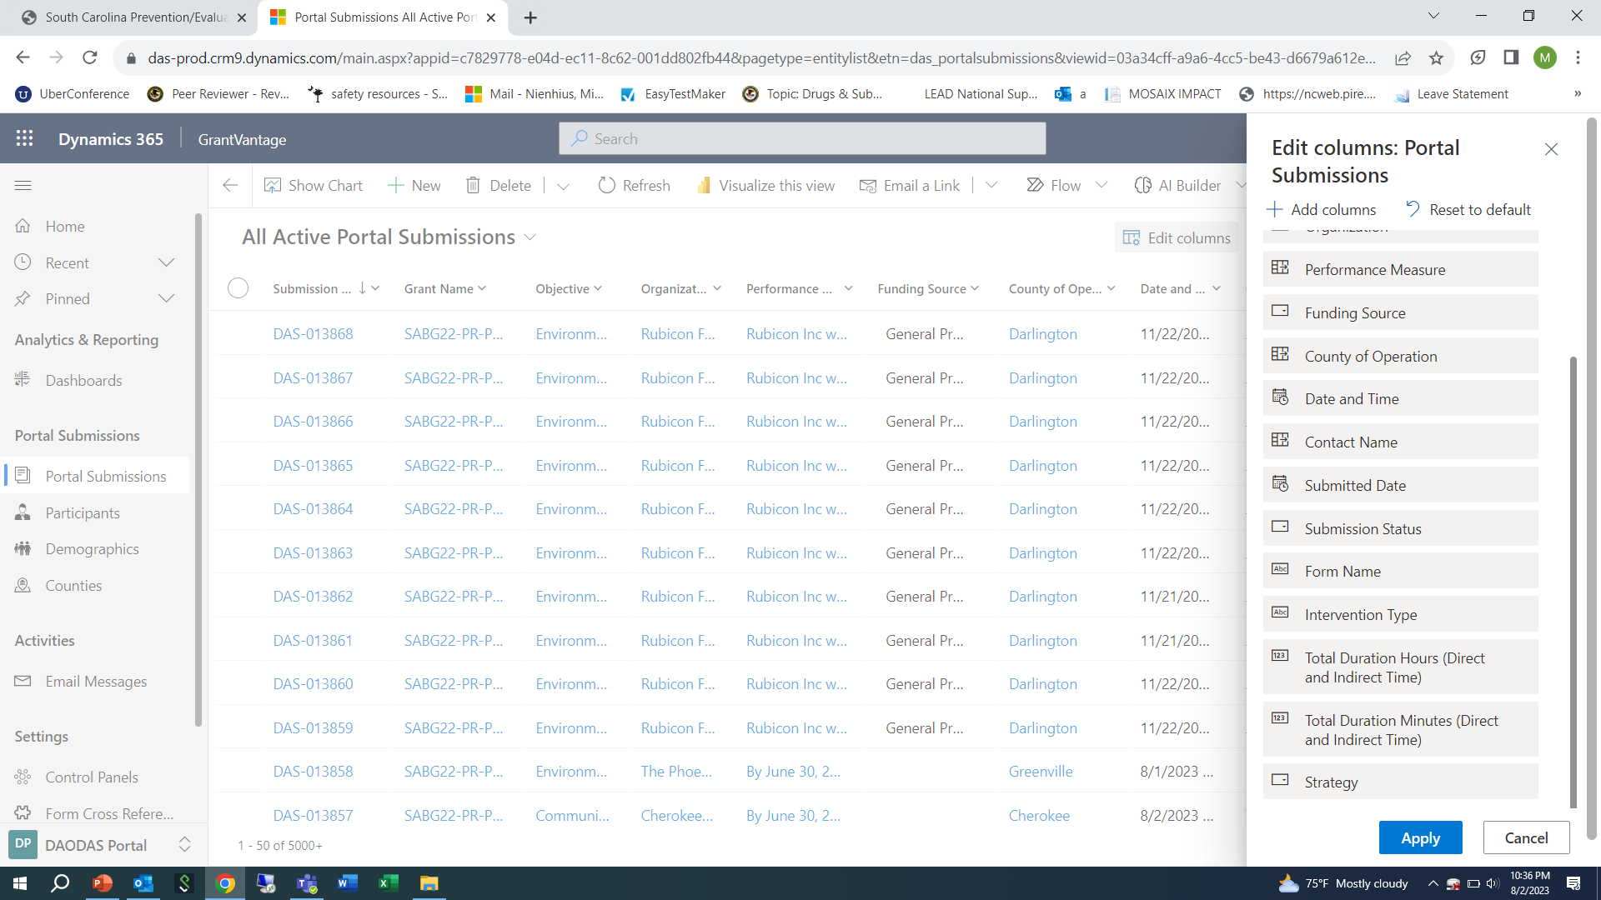
5. Click “blue apply” button and this will return you to the Portal Submission view-now it will have the additional columns you added in visible as you scroll to the right.

Slide 10
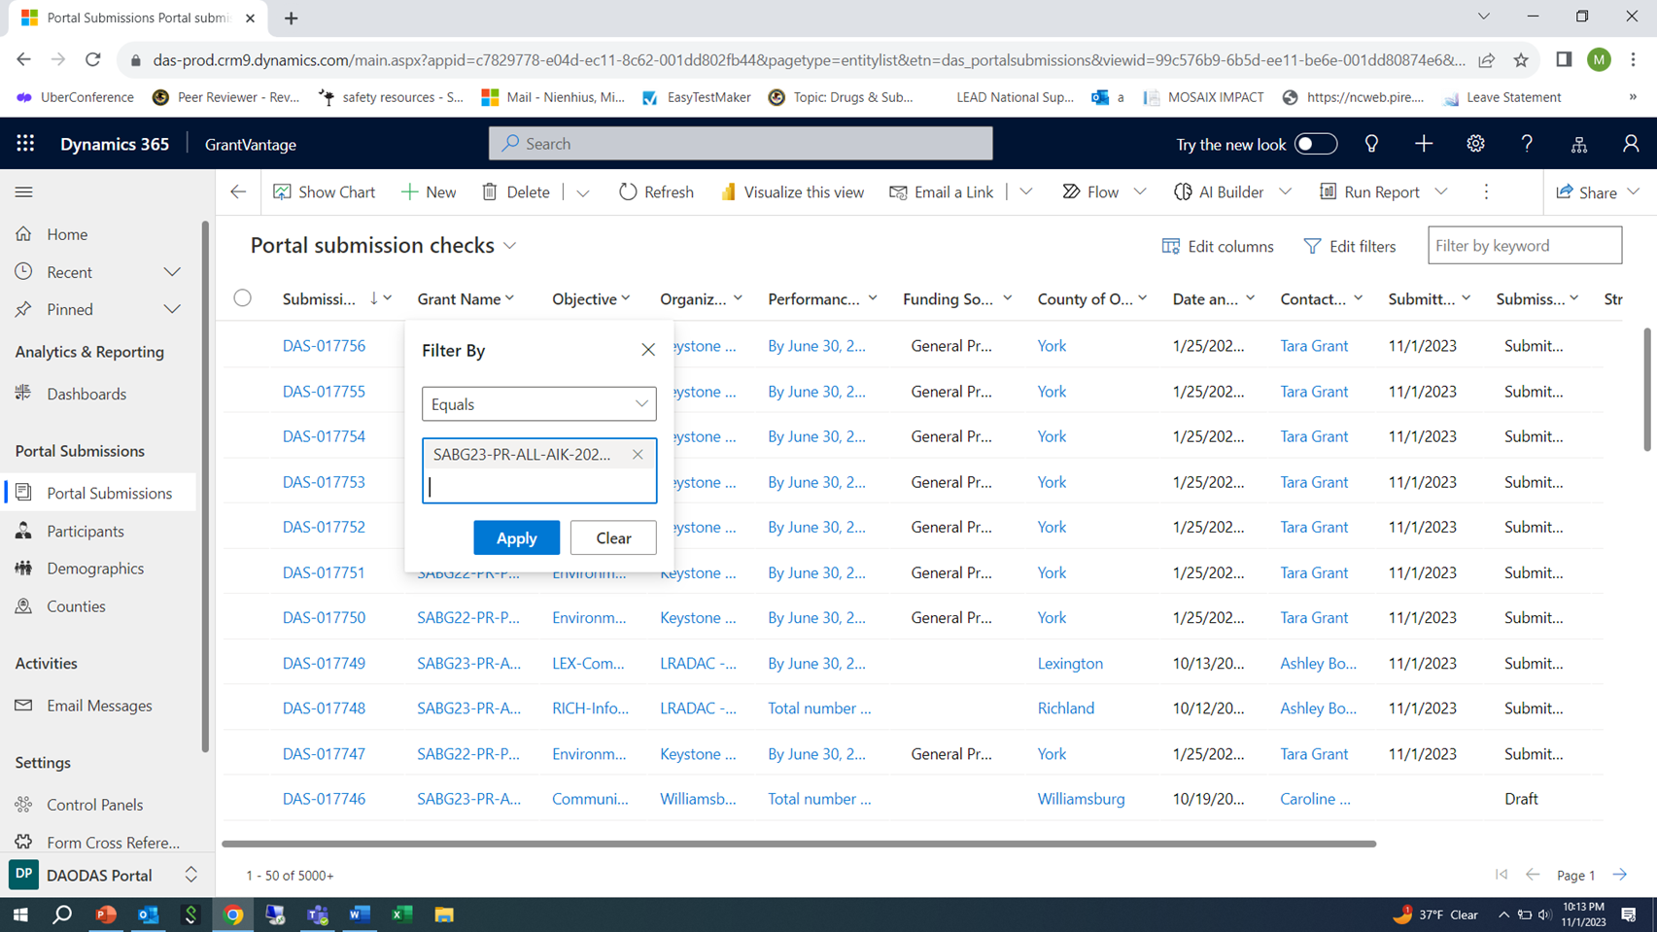
6. Click on arrow beside “Grant Name” then “Filter By” – Equals and type in “SABG23” to bring up a list to choose from for your county’s grant. Click “Apply” once you have selected your agency’s grant to view the data entered under that project.

Slide 11
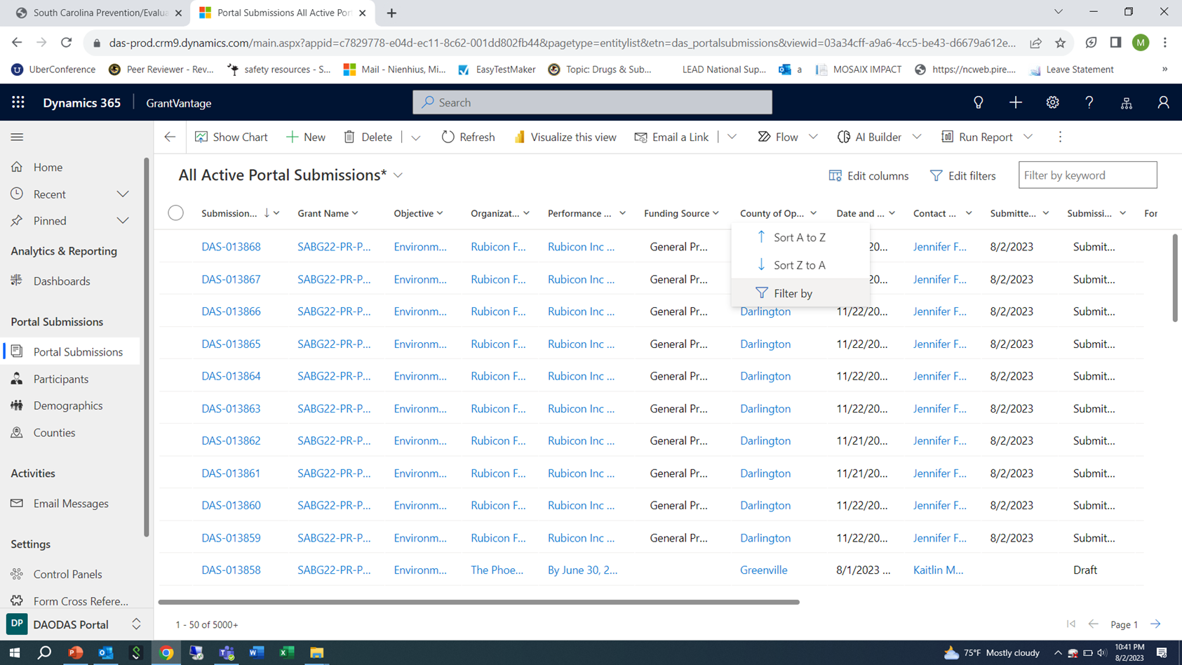
7. Click on arrow beside “County of Operation” then “Filter By” to bring a drop down menu where you can type in all of the counties you want to view (one or more). This will filter the view to only show the data for the counties you want to view. Click “Apply” once you have selected the county or counties you want to view.

Slide 12
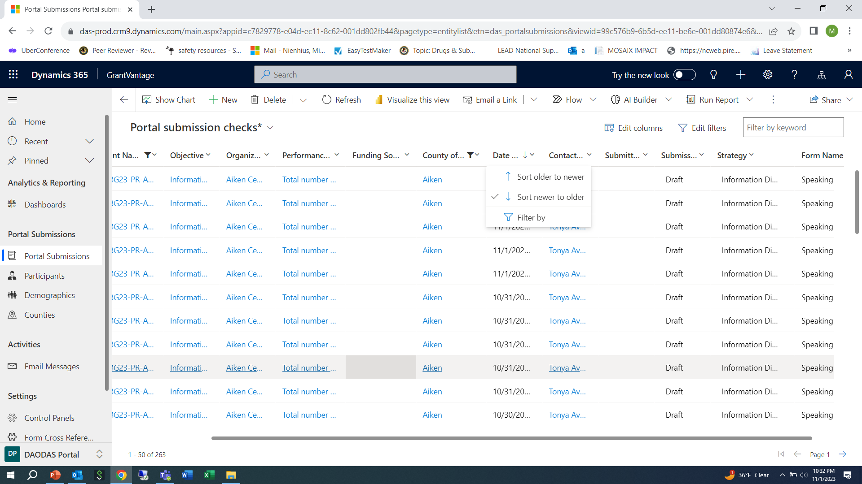
8. Click on arrow beside “Date and Time” then select “Newer to older”. This will filter the service dates on the forms from the most recent to the oldest.

Slide 13
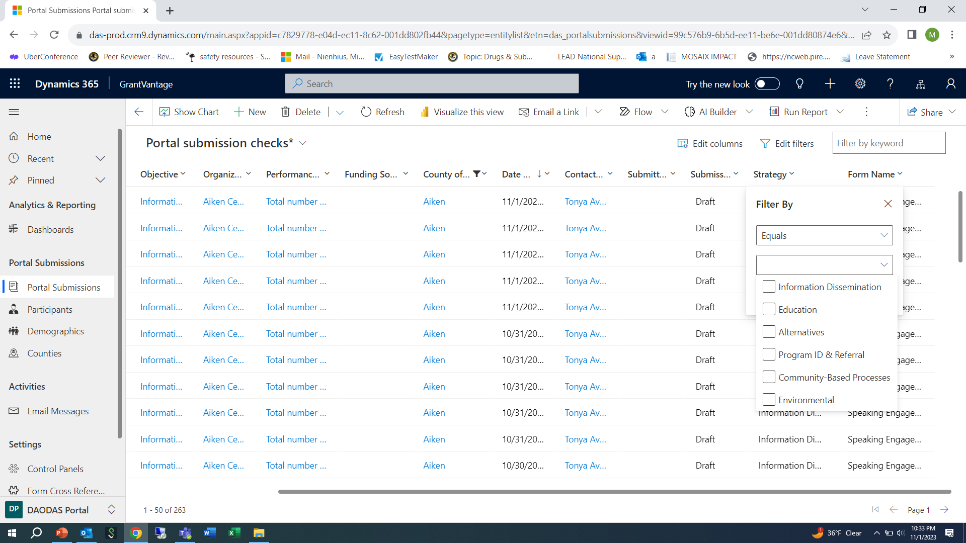
9. Click on arrow beside “Strategy” then a “Filter By” box will open up. When you click on the arrow, it will bring up the 6 strategies and you can filter by the strategy you want to see. Once you make a selection, click apply and the data will filter to bring up the forms related to that strategy from newest to oldest date-both draft and submitted.

Slide 14
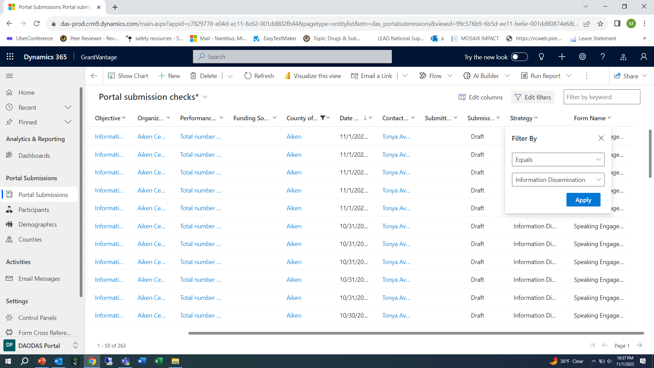

Slide 15
Planning time for the month should be entered in a form related to the strategy even if the strategy service date will be in another month.
For example, if a speaking engagement will be conducted on December 1 and the staff begins planning for the event in November, go ahead and open the form and enter planning time in the form.
A note should be placed in the “description” section of the form with a brief explanation of the planning time attributed to the service.
Objective should line up with strategy. For example, you would not have a problem identification and referral objective with an information dissemination strategy and speaking engagement form.

Slide 17
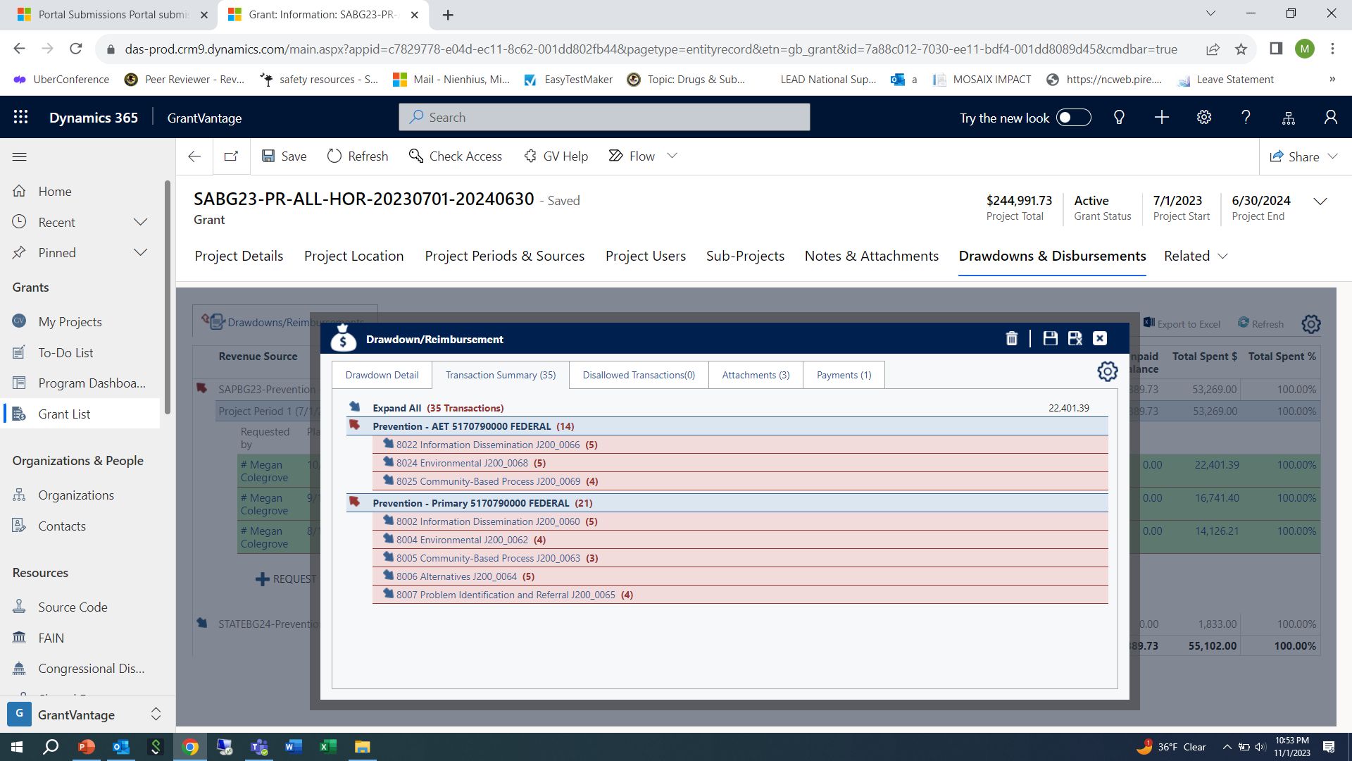
It is through these views that DAODAS can filter the data and compare the service forms entered (both in draft and submitted) to the monthly financial reimbursement request.

Slide 19
In this example, service data (at least one form) for September would include forms entered into the data portal (either in submitted or draft) status for the following strategies:
Information Dissemination
Environmental
Community- Based Process
Alternatives
Problem Identification and Referral

Slide 20
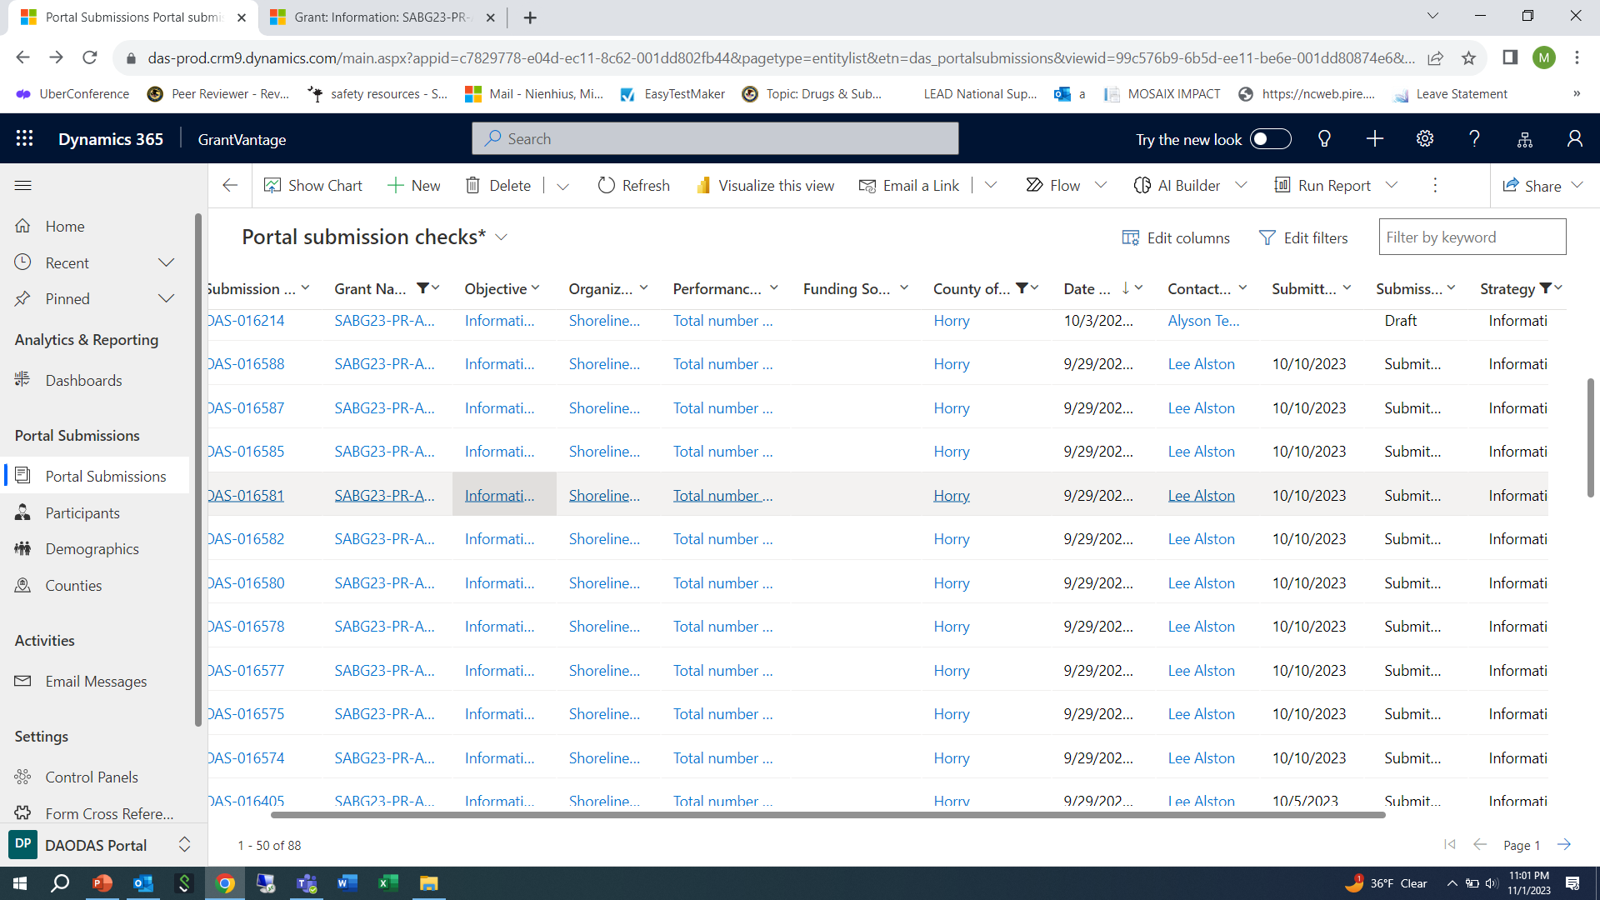

Slide 21
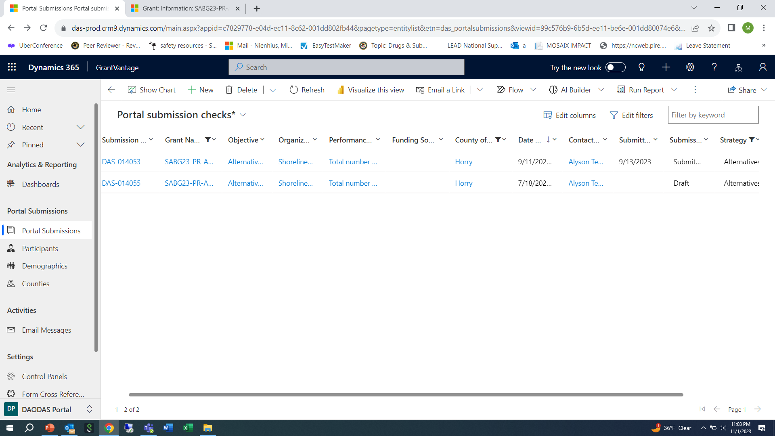

Slide 22
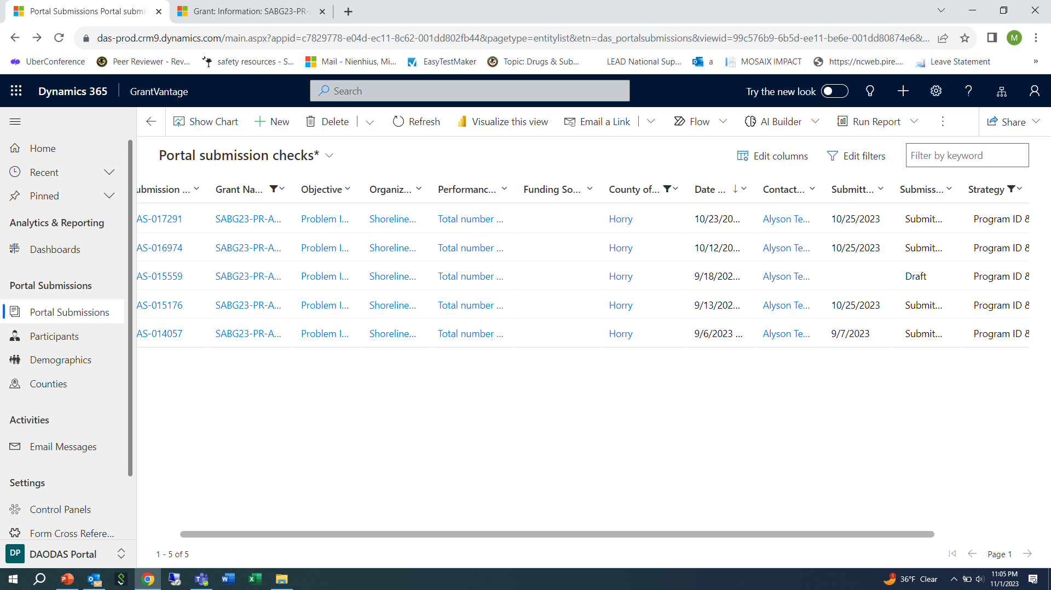

Slide 23
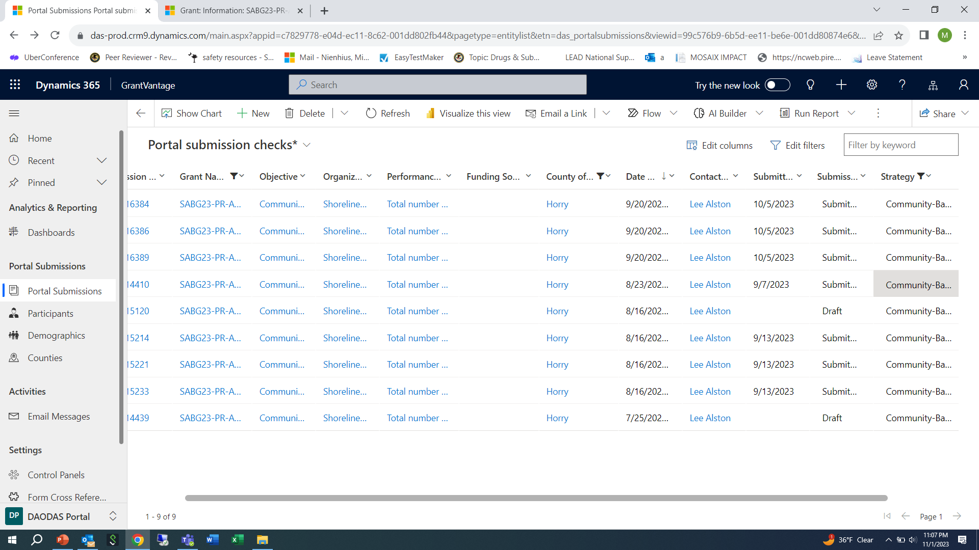

Slide 24
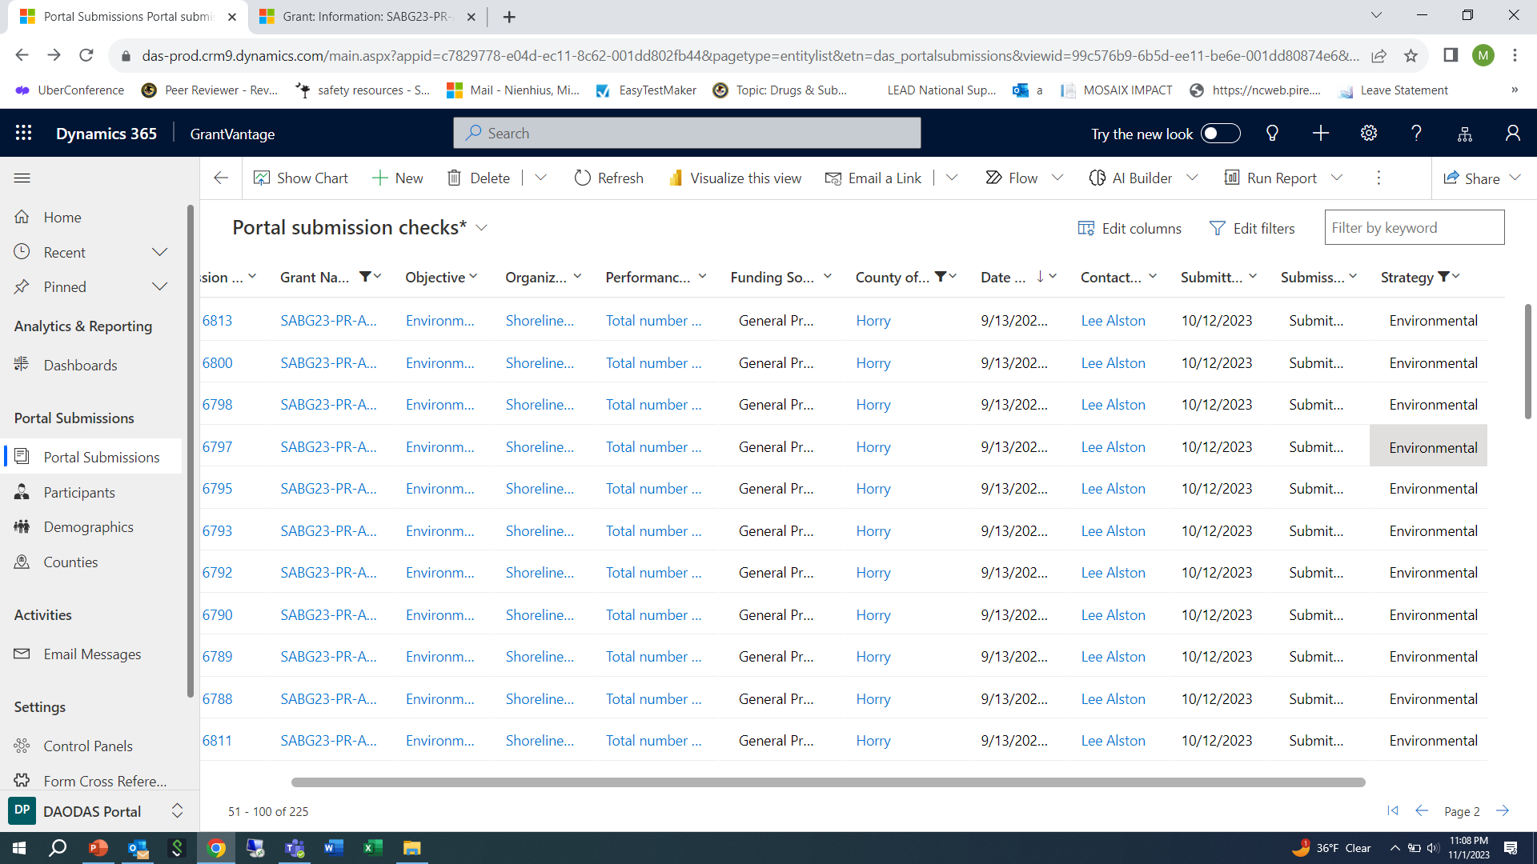

Slide 25
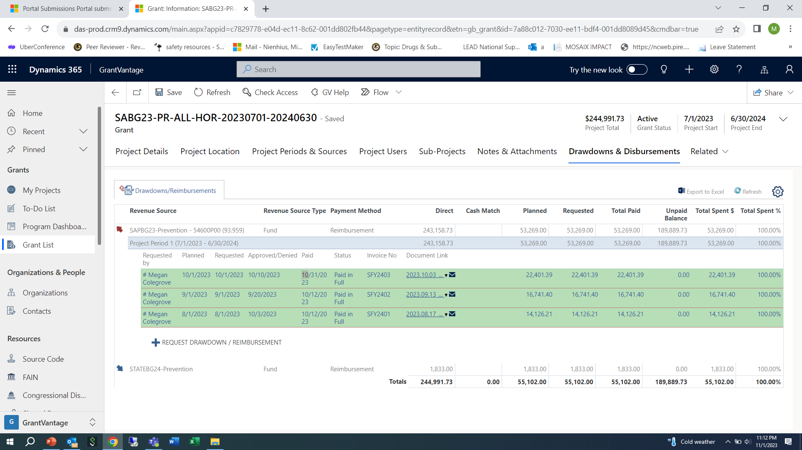
The data submitted aligns with the request- DAODAS program staff changes the status from “requested” to “ approved” and notes “services on target”. At that point, DAODAS finance team will process the reimbursement request for payment. The status will stay in “approved” until the payment is made to the agency. At that time the status will change to “paid in full”.

Slide 26
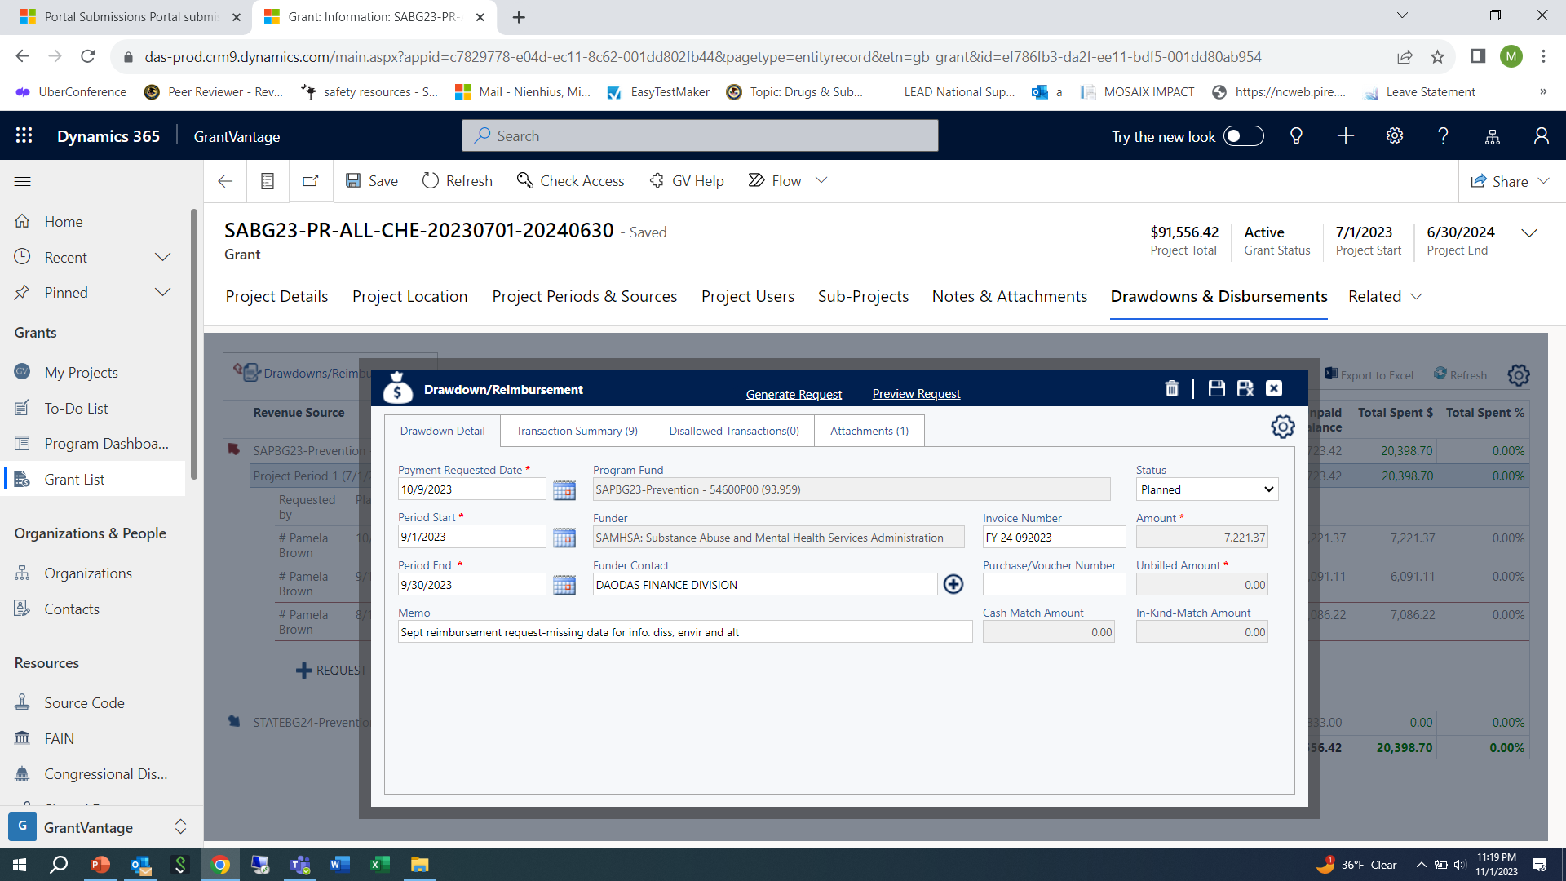
If data for any service area is missing, the “request” will be returned to “planned” status and a note will be placed in the memo related to the areas that data is missing.

Slide 27
You can also download the data to an excel file.
Click “Export to Excel”.
The file will download into your “downloads” folder.
Once the data is in Excel, you can work with the data and filter the information in many different ways. The Excel report can be shared with agency leadership as needed, finance to demonstrate services provided (or forms that are in draft) for monthly reimbursement requests, etc.
You can also just apply various filters and remove them as needed if you are only needing a “quick” view of information.

Slide 29
Contact DAODAS with any questions or technical assistance requests. We can walk you through this step-by-step as needed via TEAMS/ZOOM. (prevention@daodas.sc.gov )
You can also save the view that was built for this report in order to come back to it month to month. That way you can skip steps 3-5 related to building the custom review. Click on arrow and then click on “save as a new view”
You can build any reports with any combination of data you want and then save/name the reports for future recall.

Slide 31
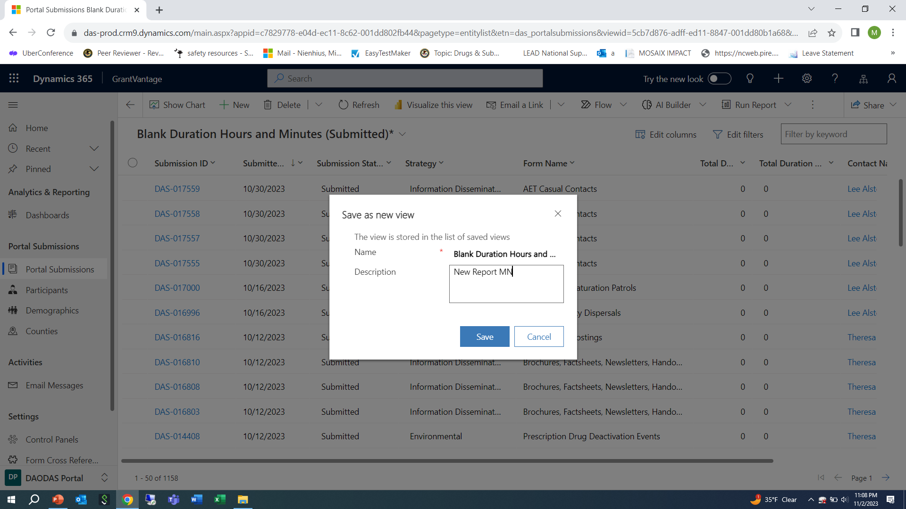
Type what you want to name the report in the “description” field and then click the blue save button. Then the report will appear in the list for you to choose from and you do not need to rebuild it each time.

Slide 32
Formatted “Canned” Reports Available in GMS:
Way Path is working on additional “canned” reports, however there are some available to view at this time.
Reports available include:
Compliance Checks
Individual-based programs and strategies
Population-based programs and strategies
Single services by demographics
Number of media impressions
Number of persons served by individual or population-based programs and strategies
Distribution of people served by gender
Distribution of people served by age
People served in 12-month period
Prevention Strategy Report is only available to DAODAS at this time
To access: Click on “reports” on bottom left of menu

Slide 33
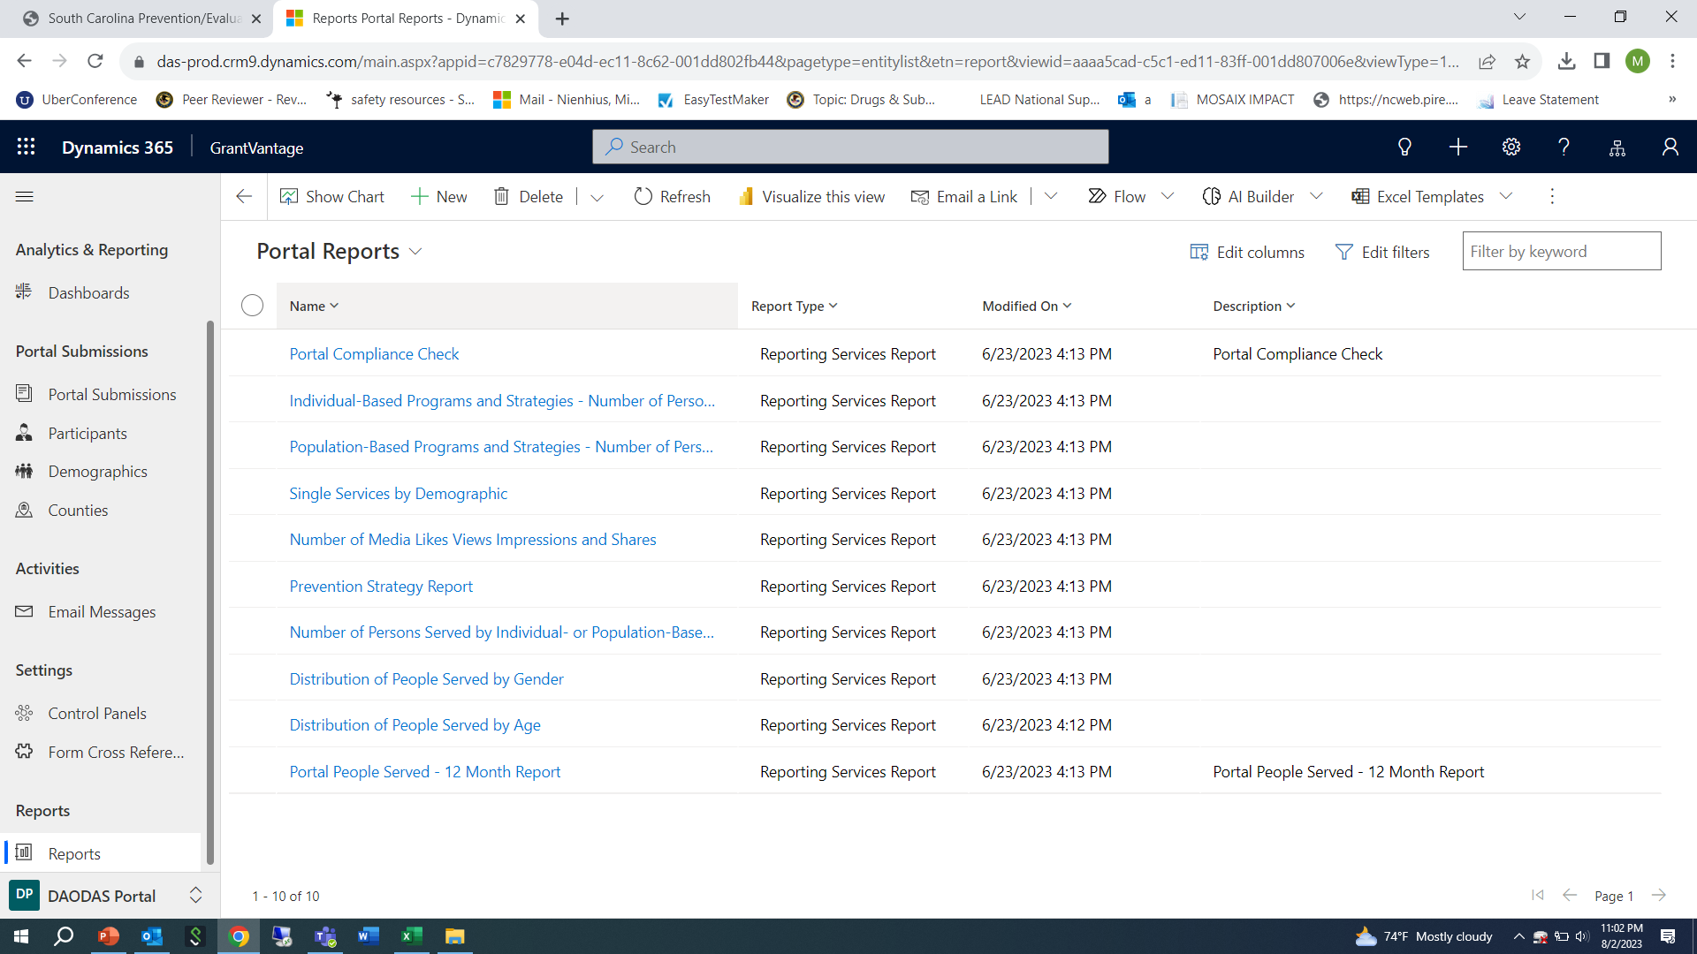

Slide 34
Choose report you want to view
When template comes up, complete the fields as suggested below:
Year: 2022
Reporting Period: SC State fiscal year July 1-June 30
Strategy: Select All (you can also narrow down by only one strategy at a time)
Intervention Type: Select All (or if you are choosing one strategy, be sure to select the right intervention type for the strategy selected)
Counties: Can choose one or multiple counties to view
Forms: Select All
Organizations: Select organization that matches the county or counties of service selected
Click “View Report”
Click on “save” icon to download report to PDF that can be provided to leadership or other partners
Contact DAODAS with any questions or technical assistance requests. We can walk you through this step-by-step as needed via TEAMS/ZOOM. (prevention@daodas.sc.gov )

Slide 35
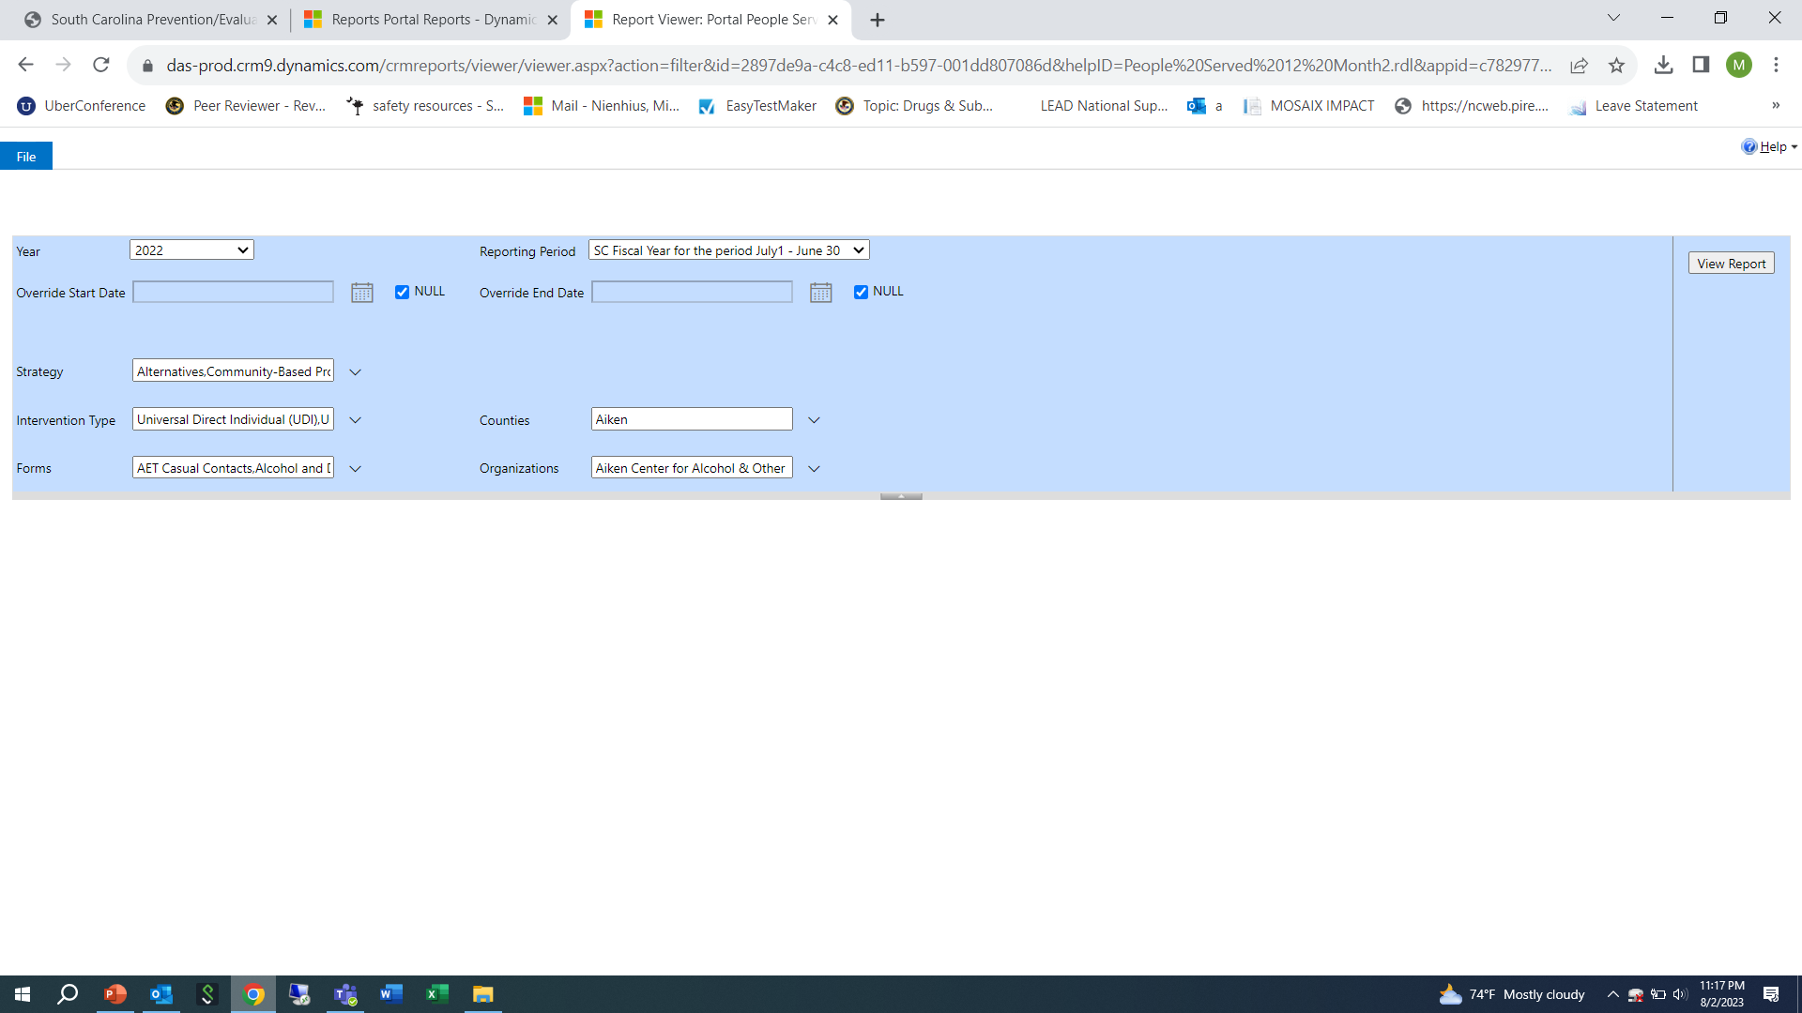

Slide 36
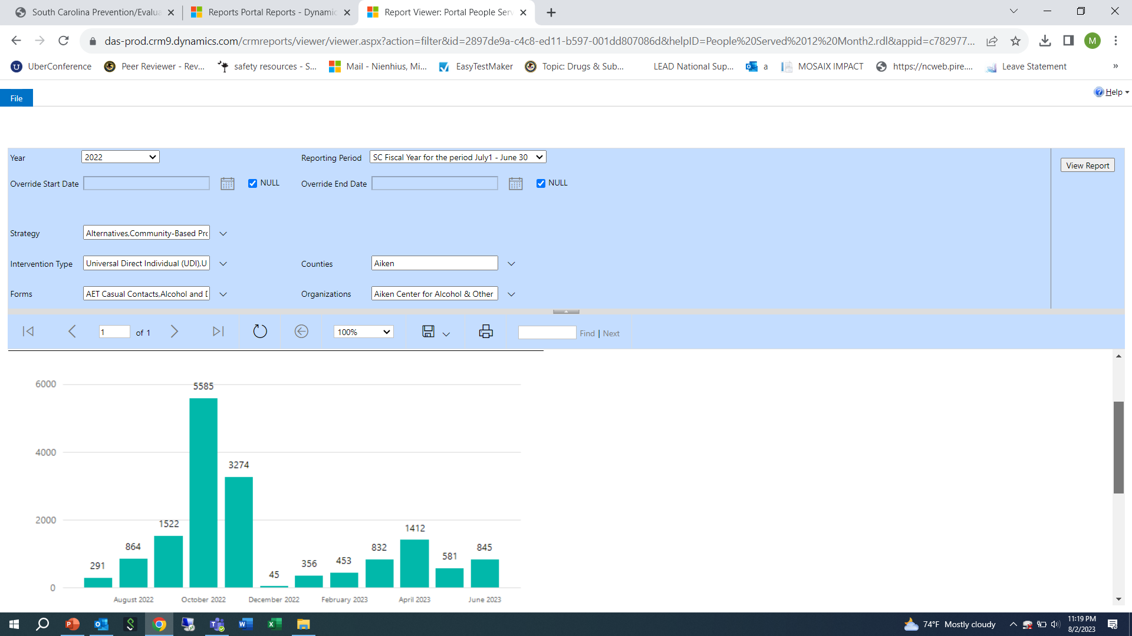

Slide 37
Questions?

